Slide 1

Back Country Horsemen of America
Membership Development
and Retention Committee

Slide 2
We Believe and Acknowledge
BCHA’s potential membership pool is limited due to our strong emphasis on the mission of ACCESS vs simply recreational lifestyle.
BCHA’s dues-paying members are the strength and backbone of the organization.
Why is BCHA not growing at a faster rate?
BCHA chapters/units must make membership a priority to attract new members and retain current members by promoting, reminding, and selling our story and values.
The question is: How can we increase and retain our membership?

Slide 3
What We Can Do - NOW!
Establish a Membership Development and Retention Committee !
HOW: Utilize the BCHW Membership Handbook and by being creative! No need to reinvent the wheel. The information and “how-to” is already available in sources listed at the end of this presentation. Each state, chapter/unit can tailor their approach for their specific needs.
A FEW IDEAS!
Everyone seeks a like-minded community. Make all feel acknowledged and valued.
Create and hand deliver or mail a “Welcome New Member Packet” to each new member.
Contact each new member personally or by phone with a “questionnaire” to learn their individual interests, expectations, preferences to get to know them.
Educate and explain how your BCH chapter/unit is organized and functions.
Provide contact information for those who may have a question at a later date.
Keep all membership aware of planned events – social and work events.
Personally introduce new members during a chapter meeting.

Slide 4
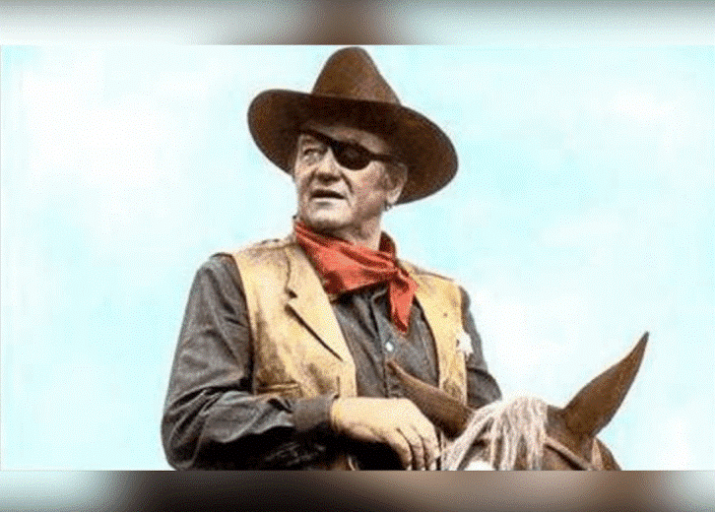

Seasoned Members New Members Keeping Members
Our Seasoned Members are working hard and faithfully. They are the ones who have the history and fought the battles over time. The problem - TIME. Our warriors are aging!
Our New Members are excited about BCHA. This is our target group to keep engaged, educated, involved, and moving their status forward to Seasoned Members.
Our newest members need guidance, education, and mentoring to fully grasp the BCH mission. For some their first motivation in joining was, “Where can I ride?” BCH is MUCH MORE than riding – It is all about ACCESS.

Slide 5
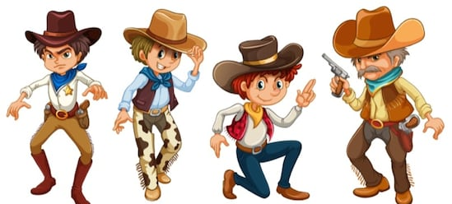

Membership Development and Retention Committee !
Who is best suited to be a part of this committee?
Who would you pick to represent your chapter?
Mr. Short Fuse
Miss “Howdy Friend!”
Mr. Exuberant and Fun
Mr. Let’s do this my way!
Who is on the Committee?
Every Chapter has a large pool of talent with great skills. The Committee should be those individuals with exuberant personalities and who are very social. They should not be hard to spot!
This is the age of Social Media. At least one member should be
Interested and skilled in managing a Chapter Facebook page
and its messaging functions. Today’s Facebook is yesterday’s
Email and newsletter. This should be a Fun Committee on which
members would love to be a part and to serve!

Slide 6

Committee Duties and Responsibilities
Let’
Let’s Do
This!
Keep Chapter Leadership informed on committee’s activities and progress.
Know BCH and its functions well. Be able to communicate it to new members. If you don’t know an answer to a question, know where to find it!
Keep all member information on a professional level.
Manage a Chapter Facebook well. Keep it up to date and relevant.
Create: New Member Packet - personally deliver.
Mentor: Friendly “interview” through questionnaire. Contact throughout first year to inform and encourage participation

Slide 7

More About the New Member Packet
What is in the Packet?
Anything that explains how your chapter/unit functions !
The packet should contain information needed for new members to understand the purpose of BCH and how to participate in their local chapter/unit. Be creative and tailor your packet to fit your chapter. There is no one way to create your packet.
IDEAS
WELCOME LETTER signed by chapter/unit appointed leadership and leadership contact information.
State or Chapter Bylaws dependent on how your BCH state is organized.
Chapter specific information.
* Calendar of work events and other meetings.
* Dues renewal schedule.
* History of BCH
* State organization contacts and meeting schedule.
* Expectations from membership and membership responsibilities to BCH
You get the idea!

Slide 8
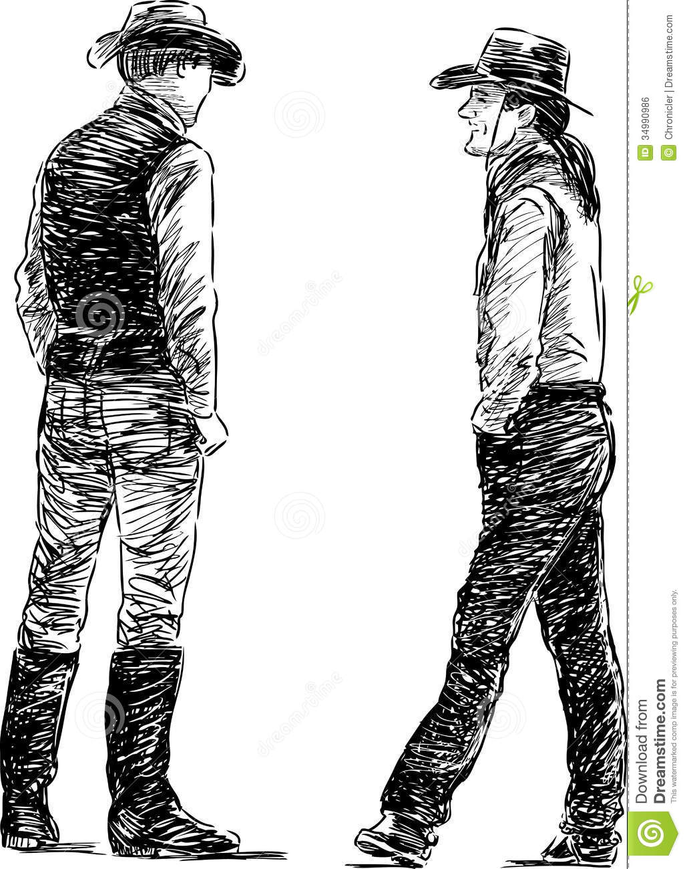
More About New Member Questionnaire! Perfect time to:
Verify member contact information: phone number(s), email, addresses, etc.
Ask about specific interests or preferences for participation in events.
Ask about delivery preference for newsletter or other information.
Ask member (if appropriate) to share one’s background and special interests and skills. Encourage them to talk about themselves.
Share your own background (if appropriate) and interests to build a sense of community.
Quiz member on their expectations of BCH to learn their knowledge level of BCH.
Be Creative: Use this to appropriately learn about member interests. This is the time to invite them to participate on all levels of BCH.

Slide 9
Membership – Retention Committee More to Consider
Why is BCHA membership declining? Things to think about!
Is our general member population aging and feel they have nothing to offer?
Approach: Everyone is of value who believes in BCH values. Checkbook members are invaluable as is their knowledge and experience to mentor others.
Do some feel disconnected, discouraged, and undervalued?
Approach: Know your members and work to engage all. Encourage, educate, and mentor them to participate.
Are members wanting MORE than working on trails?
Approach: Members seek a “community”. Maybe more social fun events need to be added to the yearly calendar of events!
Where are the younger packers and riders?
Approach: Tough question. Think outside of your “group” and brain storm on how to find, approach, and engage . Use social media! Consider contacting your local 4-H Clubs, FFA Chapters, etc.

Slide 10
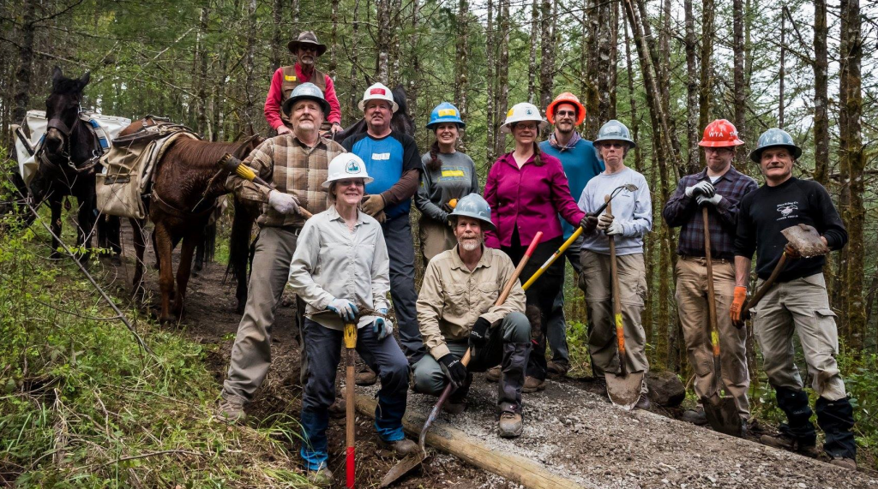
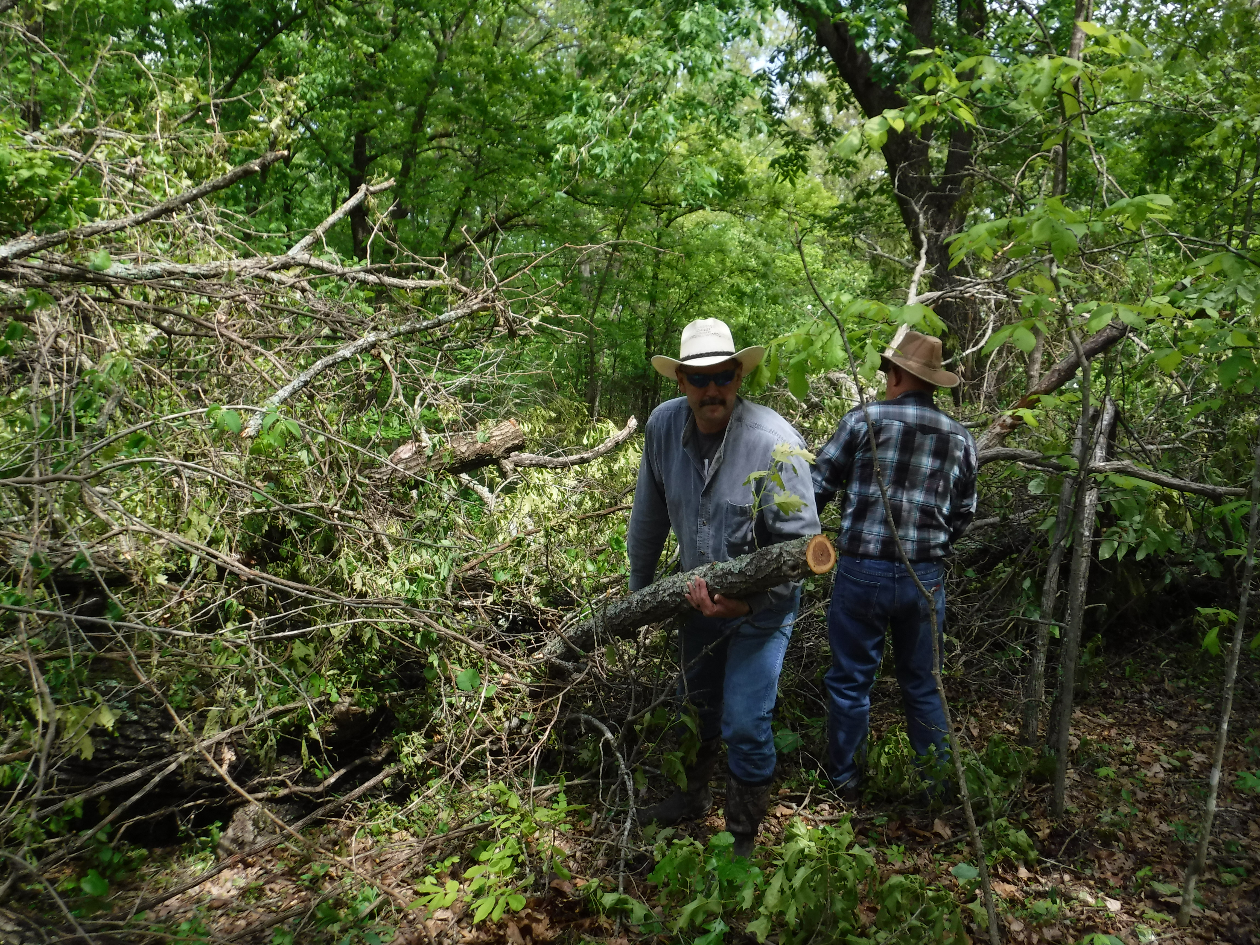

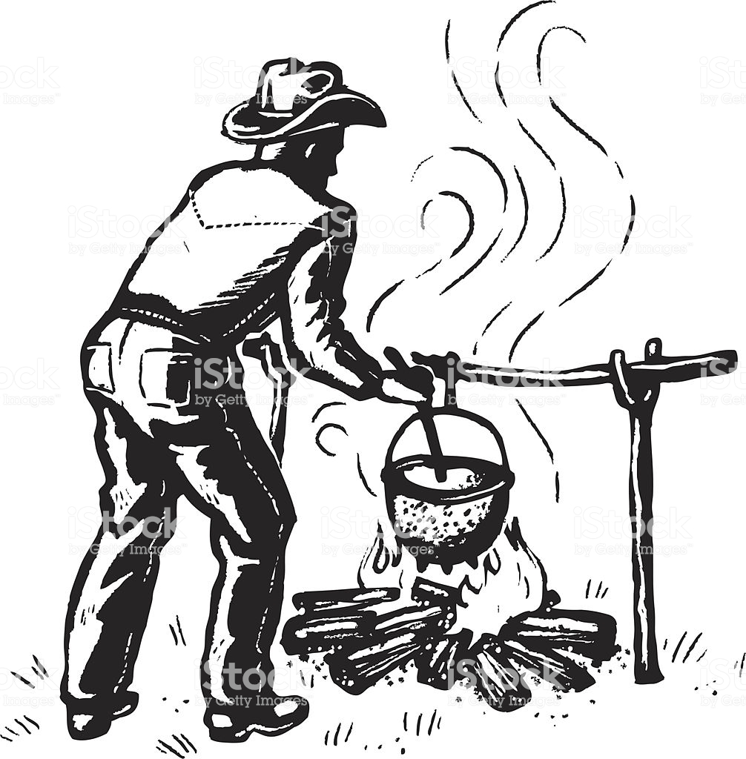

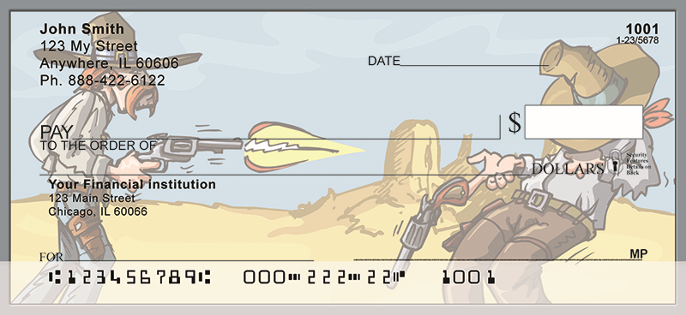
Who are our Valued Members? EVERYONE !
Our Trail Workers
Our chefs
Our shy behind the scene
workers.
Invaluable!
Our packers
Our checkbook supporters.

Slide 11
Resources
The Computer – your best Friend !
BCHA has great resource material that addresses membership issues.
Access the BCHA website: bcha.org.
Go to: Member Login
Go to: Membership Resources
Go to: Membership Ideas & Programs
Scroll down to BCHWA Membership Development Handbook
Scroll to other ideas concerning membership.
How to Use Facebook – While on BCHA website Go to: Chapter Resources
1. Go to: Education Architecture
2. Go to: BCHA 201 of the 3 spreadsheets
3. Go to: How to Use Facebook
Google “Retention of non-profit membership.” These strategies are generic in nature but good information.
Be Creative: Ask current membership their experience in joining. What they liked, what changes they would suggest.

